Slide 1
Image content based classification of
vacation/ tourism related images
16-074

Slide 2
Purpose
The purpose of this SRS document is to provide a detailed overview of the research - Image content based classification of vacation/ tourism related images
This document’s target audience is users and developers who are involved in developing this algorithm for further classification.

Slide 3
Scope
This document contains all the requirements for developing the proposed algorithm.
In this document we mainly focus on aspects of our system functions.
The scope is limited to explain only the functions. And the boundaries of the research It will not explain the implementation phase in detail.

Slide 4
Overall Description
Image spatial representation and segmentation is the first step of our algorithm which separate the pixels of the image initially and then check the pixels whether they are in same region or not.
To do this process more accurately, we use random forest algorithm which has many decision trees.
Then image should be formed in order to output a meaningful object. Image formation process is used for that purpose.

Slide 5
Overall Description Contd...
Well-formed objects are input to the neural network to label the objects or identify the objects. To identify the objects in images, first we need to train sample objects.
From the identified objects in the image, context should be classified.

Slide 6
Product Perspective
[1] has used “splitting and merging” method for image segmentation which has a pyramidal structure.
But there is a problem that any two regions may be merged if adjacent and if the larger region satisfies the homogeneity criteria
[2] has used histogram based method which is efficient compared to others
But the problem is it's very difficult to identify the peaks and the valleys in the image.
[1] Toru Tamaki, Tsuyoshi Yamamura and Noboru Ohnishi: “Image segmentation and object extraction based on geometric features of regions”,Part of IS&T/SPIE Conf. on VCIP'99, SPIE Vol.3653, Part Two, pp.937{945 (1999 1)
[2] Linda G. Shapiro and George C. Stockman (2001): “Computer Vision”, pp 279-325, New Jersey, Prentice-Hall, ISBN 0-13-030796-3

Slide 7
Product Perspective Contd...
[3] and [4] have used convolutional neural network which trains large no of images for object identification purpose
But the problem is that their network’s performance degrades if a single convolutional layer is removed.
We use Recursive Neural Network. The advantage of using RNN is it provides a better solution to minimize the error rate.
[3] Howard, A. G., "Some Improvements on Deep Convolutional Neural Network Based Image Classification", arXiv preprint arXiv:1312.5402, 2013.
[4] Krizhevsky, A., Sutskever I., and Hinton, G., "Imagenet classification with deep convolutional neural networks", Advances in neural information processing systems, 2012.

Slide 8
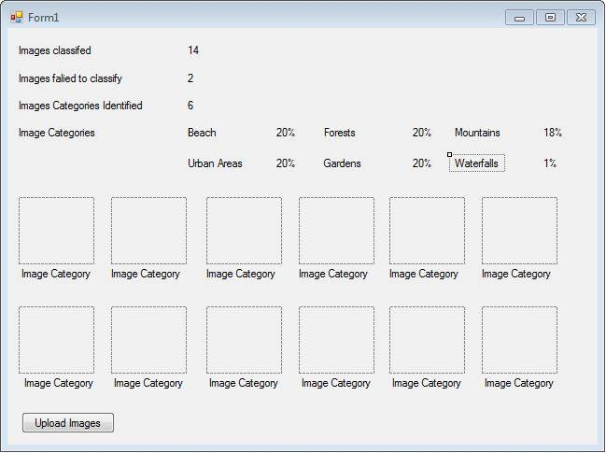
User Interface

Slide 9
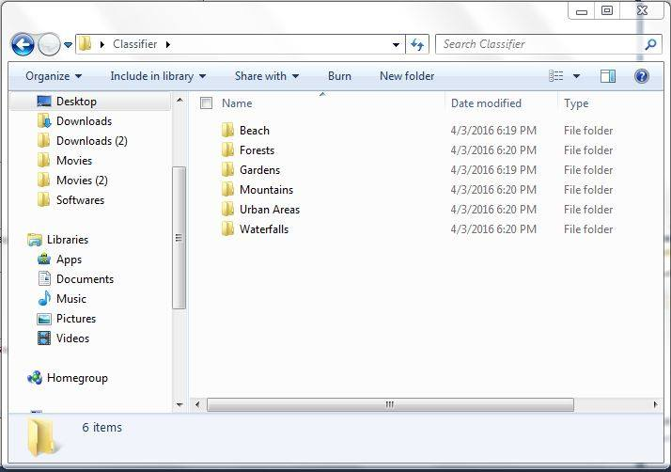

Slide 10
Software Interfaces
Python 2.7 -
This is the main environment for building the algorithms
MySQL -
This is for storing the sample images in the database
MATLAB -
Testing environment which used to check the algorithms are working
properly or not.

Slide 11
Communication Interface
Initially we develop this algorithm for the desktop application. So that Internet connection is not required at that moment. When we use this algorithm in a web application then user must have a proper Internet connection.

Slide 12
High Level Diagram

Slide 13
Use case

Slide 14
Constraints
User must have an Internet connection.
This algorithm is only considered about the images related to travel and tourism.
This algorithm will operate on PCs running on Windows 7 or later at a minimum speed of 2.2GHZ

Slide 15
Apportioning Requirement
Essential Requirement
Allow user to upload images to be classified
User upload images should be segmented.
Desirable Requirements
Use this algorithm as a web service for the travelling/tourism related applications for get the user preferences and suggest the places where user wish to visit.
Optional Requirements
Connect with social profiles, check the contents and suggest the places according to their desires.

Slide 16
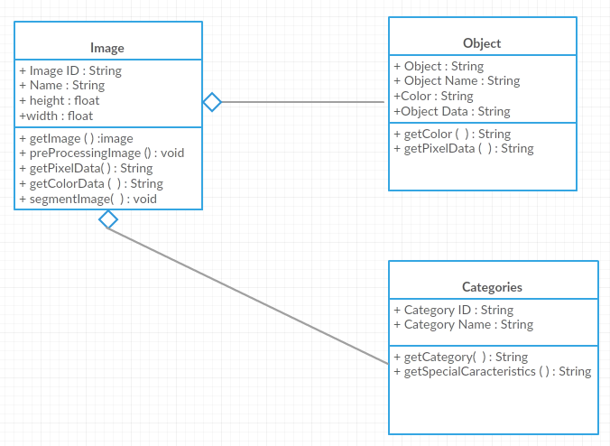
Class Diagram

Slide 17
Performance Requirement
Since this algorithm needs more processing power, the system will require at least 2GB RAM
The processor speed should be at least 2.2 GHZ.

Slide 18
Software system attributes
Reliability -
This algorithm should be able to identify objects in the image more accurately with the limited time
Availability -
This system should be available for any web user and they must have a proper Internet connection for maintaining availability.
Security -
The sample images are stored in the database. Therefore security is needed. And when user closed the application, uploaded images must be removed from the system.

Slide 19
Software system attributes contd...
4. Maintainability -
a. The system should be able to classify the images properly after the maintenance has done and updated categories also need to be classified and give output correctly.

